Slide 1
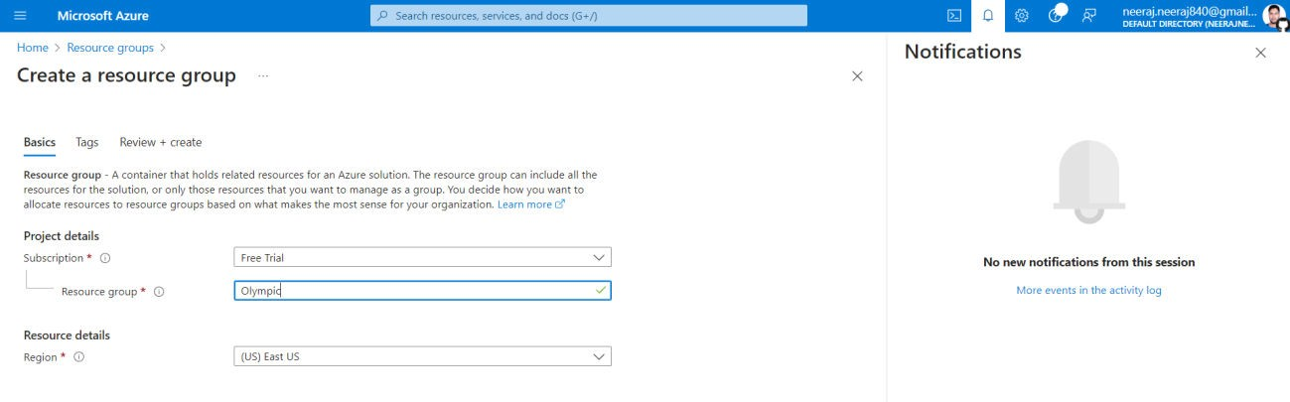
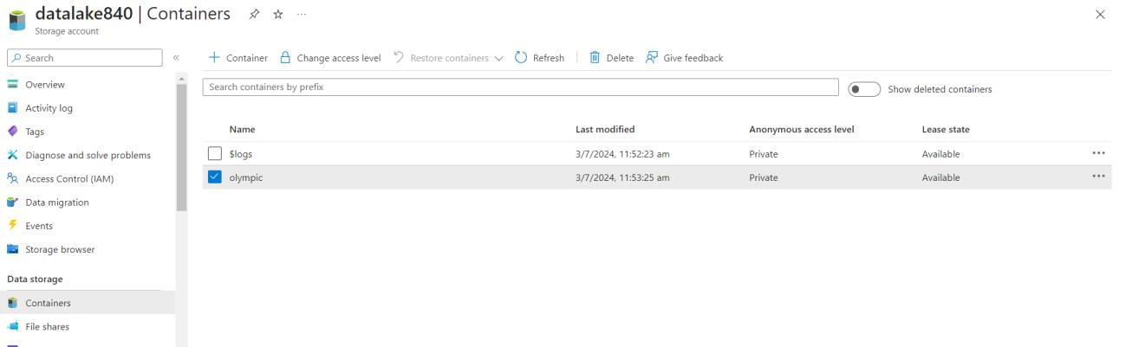
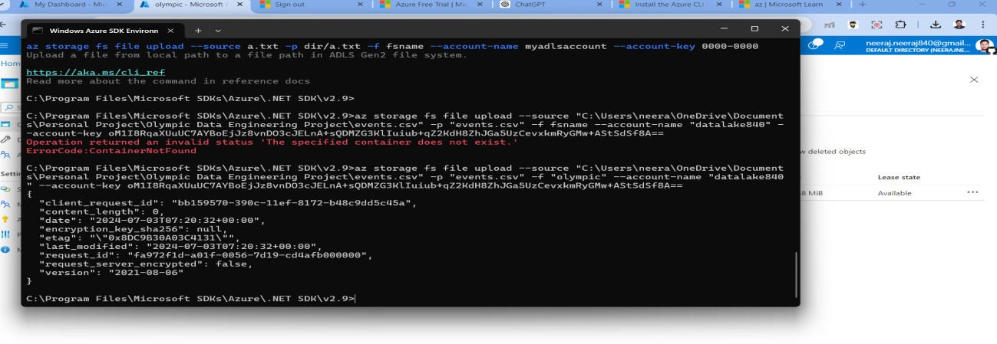
Olympic Data Engineering Project
1. Created a Azure resource group
2. Create a data lake storage and add Olympic container.
3. Use Azure CLI command prompt to migrate csv from local to ADL storage:
Create Azure Synapse Analytics resource Group and lauch synapse studio
  Create a database Olympic

Slide 2
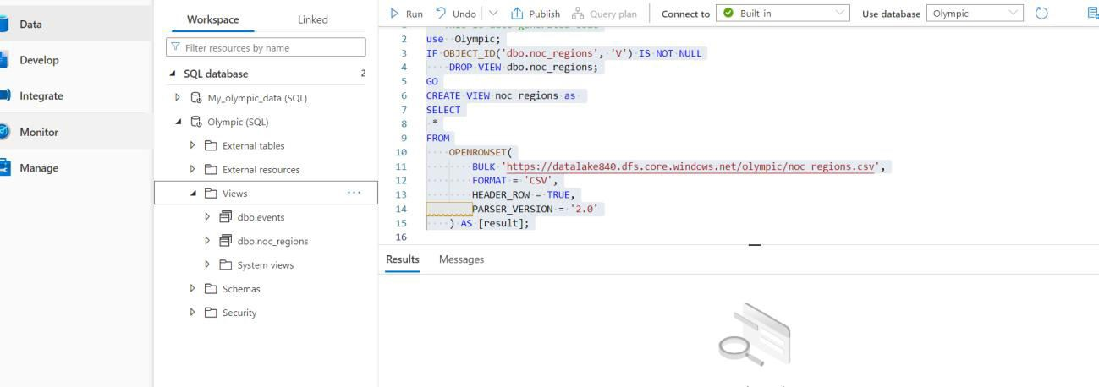
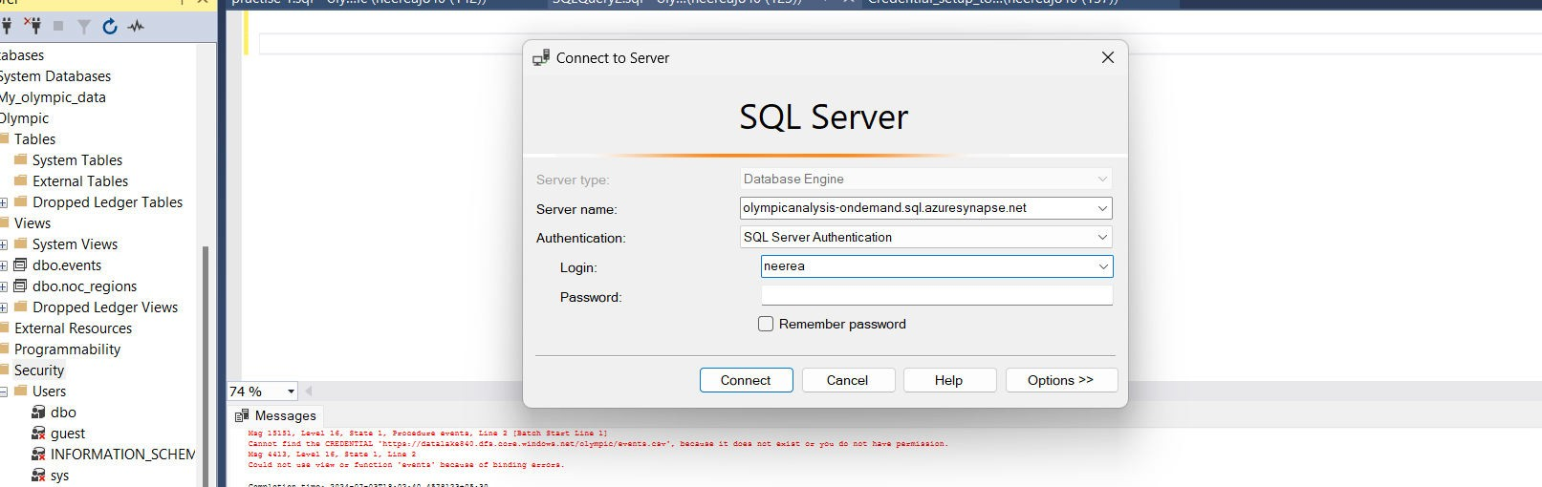
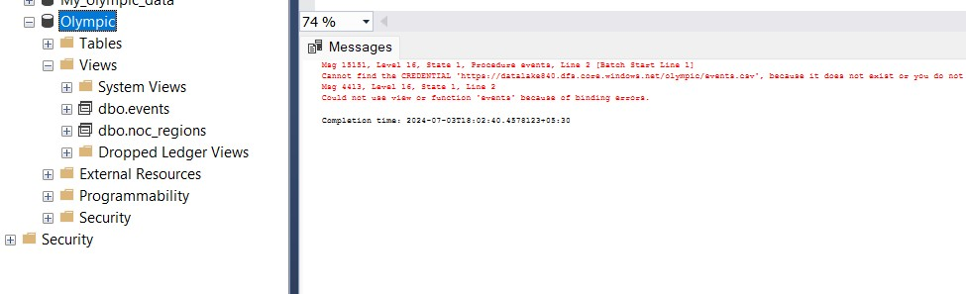
b. Query tables stored in ADL using linked service and store it as views in Olympic database.
c. Refer to regionView.sql and eventsView.sql script file.
5. Stage the olympic Database on the premises SSMS server
by connecting using Database Engine and providing Azure SQL server credentials.
a. Database has been mounted on SSMS

Slide 3
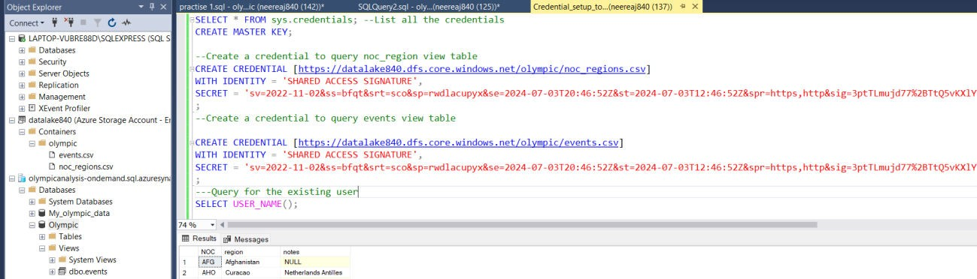
In order to Query view table on SSMS need to setup credentials.
  Generate SAS token to authenticate ADL.
  Use that token and tables file path stored in ADL to create credentials for all required tables.
c. Now views have been authenticated and could be read.
7. Now query views to derive information from tables use olympic;
describe events;
-- STEP 1. Understand the
dataxxxxxxxxxxxxxxxxxxxxxxxxxxxxxxxxxxxxxxxxxxxxxxxx xxxxxxxxxxxxxxxxxxxxxxxxxxxxxx
SELECT * FROM events; select * from Noc_regions;
select count(*) from Noc_regions;
with t as (SELECT distinct(region) FROM NOC_REGIONS) select count(*) from t;
select count(*) from (SELECT distinct(noc) FROM NOC_REGIONS) ;
select * from events order by year;

Slide 4
-- Data Analysis xxxxxxxxxxxxxxxxxxxxxxxxxxxxxxxxxxxxxxxxxxxxxxxxxxxx xxxxxxxxxxxxxxxxxxxxxxxxxxx
-- 1. How many olympics games have been held?
-- Ans 51
with oly as
(Select year, season from events group by year, season
)
select count(*) from oly;
--
xxxxxxxxxxxxxxxxxxxxxxxxxxxxxxxxxxxxxxxxxxxxxxxxxxxx xxxxxxxxxxxxxxxxxxxxxxxxxxxxxx
-- 2. List down all Olympics games held so far.
SELECT distinct YEAR, SEASON , CITY FROM events order by year;
--
xxxxxxxxxxxxxxxxxxxxxxxxxxxxxxxxxxxxxxxxxxxxxxxxxxxx xxxxxxxxxxxxxxxxxxxxxxxxxxxxxx
-- 3. Mention the total no of nations who participated in each olympics game?
with all_countries as
(select games, nr.region from events e
join noc_regions nr ON nr.noc = e.noc

Slide 5
group by games, nr.region) select games, count(region) from all_countries
group by games order by games;
--
xxxxxxxxxxxxxxxxxxxxxxxxxxxxxxxxxxxxxxxxxxxxxxxxxxxx xxxxxxxxxxxxxxxxxxxxxxxxxxxxxx
-- 4. Which year saw the highest and lowest no of countries participating in olympics
with all_countries as (select games, nr.region from events e
join noc_regions nr ON nr.noc = e.noc
group by games, nr.region), total_countries as
(select games, count(region) total_country from all_countries
group by games),
ans as (select concat(games,"_",total_country) max_min_country from total_countries where
total_country=(select max(total_country) from total_countries) or
total_country=(select min(total_country) from total_countries))

Slide 6
select a.max_min_country lowest_Country,b.max_min_country Highest_Country
from ans a, ans b
where a.max_min_country != b.max_min_country limit 1
;
--
xxxxxxxxxxxxxxxxxxxxxxxxxxxxxxxxxxxxxxxxxxxxxxxxxxxx xxxxxxxxxxxxxxxxxxxxxxxxxxxxxxXXXXXXXXXX
-- 5. Which nation has participated in all of the olympic games
with plays as
(select nr.region, games, count(games) over(partition by nr.region) games_participated
from events e
join noc_regions nr ON nr.noc = e.noc group by nr.region,games)
Select distinct region, games_participated from plays
where games_participated= (select max(games_participated) from plays) ;
--
xxxxxxxxxxxxxxxxxxxxxxxxxxxxxxxxxxxxxxxxxxxxxxxxxxxx xxxxxxxxxxxxxxxxxxxxxxxxxxxxxxXXXXXXXXXX

Slide 7
-- 6. Identify the sport which was played in all summer olympics
select * from events;
with summer as
(select year, season from events where season="Summer"
group by year, season), SPORTS AS (
select year,sport, count(sPORT)over(partition by sport) SUMMER_COUNT from events
where season="Summer" group by year,sport order by sport)
select DISTINCT SPORT, SUMMER_COUNT from SPORTS
WHERE SUMMER_COUNT= (SELECT COUNT(*) FROM SUMMER)
;
--
xxxxxxxxxxxxxxxxxxxxxxxxxxxxxxxxxxxxxxxxxxxxxxxxxxxx xxxxxxxxxxxxxxxxxxxxxxxxxxxxxxXXXXXXXXXX
-- 7. Which Sports were just played only once in the olympics.

Slide 8
with game_no as
(select games,sport, count(sPORT)over(partition by sport) games_count from events
group by games,sport order by sport)
select games , sport, games_count from game_no where games_count=1;
--
xxxxxxxxxxxxxxxxxxxxxxxxxxxxxxxxxxxxxxxxxxxxxxxxxxxx xxxxxxxxxxxxxxxxxxxxxxxxxxxxxxXXXXXXXXXX
-- 8. Fetch the total no of sports played in each olympic games.
with ngames as
(select games, sport from events group by games,sport)
select distinct games, count(sport) over(partition by
games order by games) No_of_sports from ngames;
--
xxxxxxxxxxxxxxxxxxxxxxxxxxxxxxxxxxxxxxxxxxxxxxxxxxxx xxxxxxxxxxxxxxxxxxxxxxxxxxxxxxXXXXXXXXXX
-- 9. Fetch oldest athletes to win a gold medal

Slide 9
describe events;
-- convert age, height, weight datatype from text to int
-- step 1. replace NA with null
SET SQL_SAFE_UPDATES = 0;
update events
set age=null where age="NA"; update events
-- unable safe update mode
set height = null where height = 'NA'; update events
set weight=null where weight="NA";
-- -- step 2. Modify the data type alter table events
modify column height int, modify column weight int, modify column age int;
--- Now solve
select * from events;
select distinct medal from events; select * from events
where medal="Gold" and age=(select max(age) from events where Medal="gold")
order by age;

Slide 10
--
xxxxxxxxxxxxxxxxxxxxxxxxxxxxxxxxxxxxxxxxxxxxxxxxxxxx xxxxxxxxxxxxxxxxxxxxxxxxxxxxxxXXXXXXXXXX
-- 10. Find the Ratio of male and female athletes participated in all olympic games.
with t1a as
(select sex from events
group by id,sex), t1 as
(select sex, count(1) as cnt from t1a
group by sex), t2 as
(select *, row_number() over(order by cnt) as rn from t1),
min_cnt as
(select cnt from t2 where rn = 1), max_cnt as
(select cnt from t2 where rn = 2)
select concat('1 : ', round(max_cnt.cnt/min_cnt.cnt, 2)) as ratio
from min_cnt, max_cnt; select sex, count(1) as cnt
from events group by sex;

Slide 11
with t1a as
(select sex from events
group by id,sex),
t1 as
(select sex, count(1) as cnt from t1a
group by sex)
select concat('1 : ', round((select cnt from t1 where sex='M')/(select cnt from t1 where sex='F'), 2)) as ratio
from t1;
--
xxxxxxxxxxxxxxxxxxxxxxxxxxxxxxxxxxxxxxxxxxxxxxxxxxxx xxxxxxxxxxxxxxxxxxxxxxxxxxxxxxXXXXXXXXXX
-- 11. Fetch the top 5 athletes who have won the most gold medals.
SELECT * FROM EVENTS;
with player as
(select id, Name, medal, Count(medal) medal_no from events
where medal="Gold"
group by id, Name)
select * from player order by medal_no desc limit 5;

Slide 12
--
xxxxxxxxxxxxxxxxxxxxxxxxxxxxxxxxxxxxxxxxxxxxxxxxxxxx xxxxxxxxxxxxxxxxxxxxxxxxxxxxxxXXXXXXXXXX
-- 12. Fetch the top 5 athletes who have won the most medals (gold/silver/bronze)
with player as
(select id, Name, Count(medal) medal_no from events where medal !="NA"
group by id, Name)
select * from player order by medal_no desc limit 5;
--
xxxxxxxxxxxxxxxxxxxxxxxxxxxxxxxxxxxxxxxxxxxxxxxxxxxx xxxxxxxxxxxxxxxxxxxxxxxxxxxxxxXXXXXXXXXX
-- 13. Fetch the top 5 most successful countries in olympics. Success is defined by no of medals won.
with country as
( select team,count(medal) n_medal from events where medal!="NA"
group by team)
select *, rank() over(order by n_medal desc) RANKS from country;

Slide 13
--
xxxxxxxxxxxxxxxxxxxxxxxxxxxxxxxxxxxxxxxxxxxxxxxxxxxx xxxxxxxxxxxxxxxxxxxxxxxxxxxxxxxxxxxxxxxxxxxxxxxxxx
-- 14. List down total gold, silver and bronze medals won by each country.
SELECT * FROM EVENTS;
select team ,medal,count(medal) counts from events where medal !="NA" group by team,medal order by team
;
select region ,medal,count(medal) counts from events e join noc_regions r on e.noc=r.noc
where medal !="NA"
group by region ,medal order by region;
with medal as
(select region ,medal,count(medal) counts from events e join noc_regions r on e.noc=r.noc
where medal !="NA"
group by region ,medal order by region), medal_1 as
(SELECT
region,

Slide 14
(CASE WHEN medal = "Gold" THEN counts ELSE 0 END) AS 'Gold',
(CASE WHEN medal = "Silver" THEN counts ELSE 0 END) AS 'Silver',
(CASE WHEN medal = "Bronze" THEN counts ELSE 0 END) AS 'Bronze'
FROM medal)
select region, sum(gold) gold, sum(Silver) as silver, sum(Bronze) bronze from medal_1
group by region order by region;
--
xxxxxxxxxxxxxxxxxxxxxxxxxxxxxxxxxxxxxxxxxxxxxxxxxxxx xxxxxxxxxxxxxxxxxxxxxxxxxxxxxxxxxxxxxxxxxxxxxxxxxx
-- 15. List down total gold, silver and bronze medals won by each country corresponding to each olympic games..
with medal as
(select games,region ,medal,count(medal) counts from events e join noc_regions r on e.noc=r.noc
where medal !="NA"
group by games, region ,medal order by region),
medal_1 as (SELECT
games,region,

Slide 15
(CASE WHEN medal = "Gold" THEN counts ELSE 0 END) AS 'Gold',
(CASE WHEN medal = "Silver" THEN counts ELSE 0 END) AS 'Silver',
(CASE WHEN medal = "Bronze" THEN counts ELSE 0 END) AS 'Bronze'
FROM medal)
select games,region, sum(gold) gold, sum(Silver) as silver, sum(Bronze) bronze from medal_1
group by games,region order by region;
--
xxxxxxxxxxxxxxxxxxxxxxxxxxxxxxxxxxxxxxxxxxxxxxxxxxxx xxxxxxxxxxxxxxxxxxxxxxxxxxxxxxxxxxxxxxxxxxxxxxxxxx
-- 16. Identify which country won the most gold, most silver and most bronze medals in each olympic games.
with region as
(select games, region ,medal,count(medal) counts from events e join noc_regions r on e.noc=r.noc
where medal !="NA"
group by games,region ,medal order by region),
ranks as
(select *,concat(region,"-",counts) as ans, rank() over(partition by games,medal order by counts desc) ranks from region),

Slide 16
ans as
(select * from ranks where ranks=1)
select s.games, g.max_gold, s.max_silver, b.max_bronze from (select games,ans max_gold from ans where medal="Gold") g join (select games,ans max_silver from ans where medal="Silver") as s on g.games=s.games
join (select games, ans max_bronze from ans where medal="Bronze") as b on s.games=b.games;
--
xxxxxxxxxxxxxxxxxxxxxxxxxxxxxxxxxxxxxxxxxxxxxxxxxxxx xxxxxxxxxxxxxxxxxxxxxxxxxxxxxxxxxxxxxxxxxxxxxxxxxx
-- 17. Identify which country won the most gold, most silver, most bronze medals and the most medals in each
olympic games.
with total as
(select games, region ,count(medal) count, concat(region,"-",count(medal) ) ans from events e join
noc_regions r on e.noc=r.noc where medal !="NA"
group by games,region order by region),
total_medal as
(select *, rank()over(partition by games order by count desc) ranks from total) ,

Slide 17
total_ans as
(select games, ans from total_medal where ranks=1), region as
(select games, region ,medal,count(medal) counts from
events e join noc_regions r on e.noc=r.noc where medal !="NA"
group by games,region ,medal order by region),
ranks as
(select *,concat(region,"-",counts) as ans, rank() over(partition by games,medal order by counts desc) ranks from region),
ans as
(select * from ranks where ranks=1)
select s.games, g.max_gold, s.max_silver, b.max_bronze, ta.total_medal from (select games,ans max_gold from ans where medal="Gold") g join (select games,ans max_silver from ans where medal="Silver") as s on g.games=s.games
join (select games, ans max_bronze from ans where medal="Bronze") as b on s.games=b.games
join (select games, ans total_medal from total_ans) ta on ta.games=s.games;
--
xxxxxxxxxxxxxxxxxxxxxxxxxxxxxxxxxxxxxxxxxxxxxxxxxxxx xxxxxxxxxxxxxxxxxxxxxxxxxxxxxxxxxxxxxxxxxxxxxxxxxx

Slide 18
-- 18. Which countries have never won gold medal but have won silver/bronze medals?
with medal as
(select region ,medal,count(medal) counts from events e join noc_regions r on e.noc=r.noc
where medal !="NA" group by region ,medal order by region), medal_1 as
(SELECT
region,
(CASE WHEN medal = "Gold" THEN counts ELSE 0 END) AS 'Gold',
(CASE WHEN medal = "Silver" THEN counts ELSE 0 END) AS 'Silver',
(CASE WHEN medal = "Bronze" THEN counts ELSE 0 END) AS 'Bronze'
FROM medal), no_gold as
(select region, sum(gold) gold, sum(Silver) as silver, sum(Bronze) bronze from medal_1
group by region
order by region) select * from no_gold
where gold=0 and (silver!=0 or bronze!=0) ;

Slide 19
--
xxxxxxxxxxxxxxxxxxxxxxxxxxxxxxxxxxxxxxxxxxxxxxxxxxxx xxxxxxxxxxxxxxxxxxxxxxxxxxxxxxxxxxxxxxxxxxxxxxxxxx
-- 19. In which Sport/event, India has won highest medals.
--Ans Hockey
select * from events;
select region,sport ,count(medal) counts from events e join noc_regions r on e.noc=r.noc
where region='India' and medal is not NULL
group by region ,sport order by counts desc
;
--
xxxxxxxxxxxxxxxxxxxxxxxxxxxxxxxxxxxxxxxxxxxxxxxxxxxx xxxxxxxxxxxxxxxxxxxxxxxxxxxxxxxxxxxxxxxxxxxxxxxxxx
-- 20. Break down all olympic games where India won
medal for Hockey and how many medals in each olympic games
select region,sport ,games, count(medal) counts from events e join noc_regions r on e.noc=r.noc
where region="India" and medal!="NA" and sport="Hockey"
group by region ,sport,games

Slide 20
order by games;
--
xxxxxxxxxxxxxxxxxxxxxxxxxxxxxxxxxxxxxxxxxxxxxxxxxxxx xxxxxxxxxxxxxxxxxxxxxxxxxxxxxxxxxxxxxxxxxxxxxxxxxx
--

